Slide 1
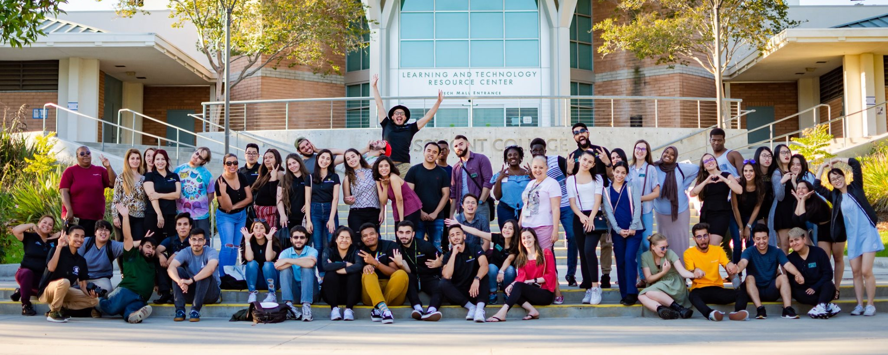
Reflecting on L.I.T.
Angel Gonzalez, Director of Student Development​
Heriberto Vasquez, Outreach Coordinator
Maria De La Cruz, EOPS Program Specialist
Wayne Branker, Admissions and Records Supervisor
An equity driven student professional development institute

Slide 2
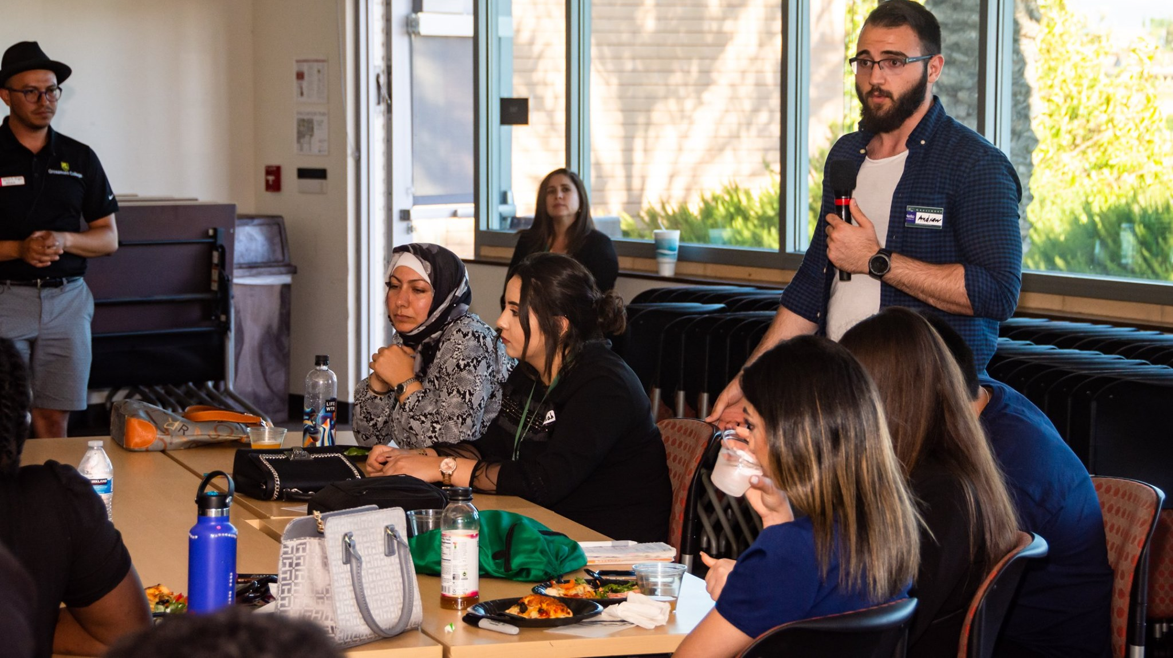
Our Training Foci
Leadership
Identity
Team Building

Slide 3
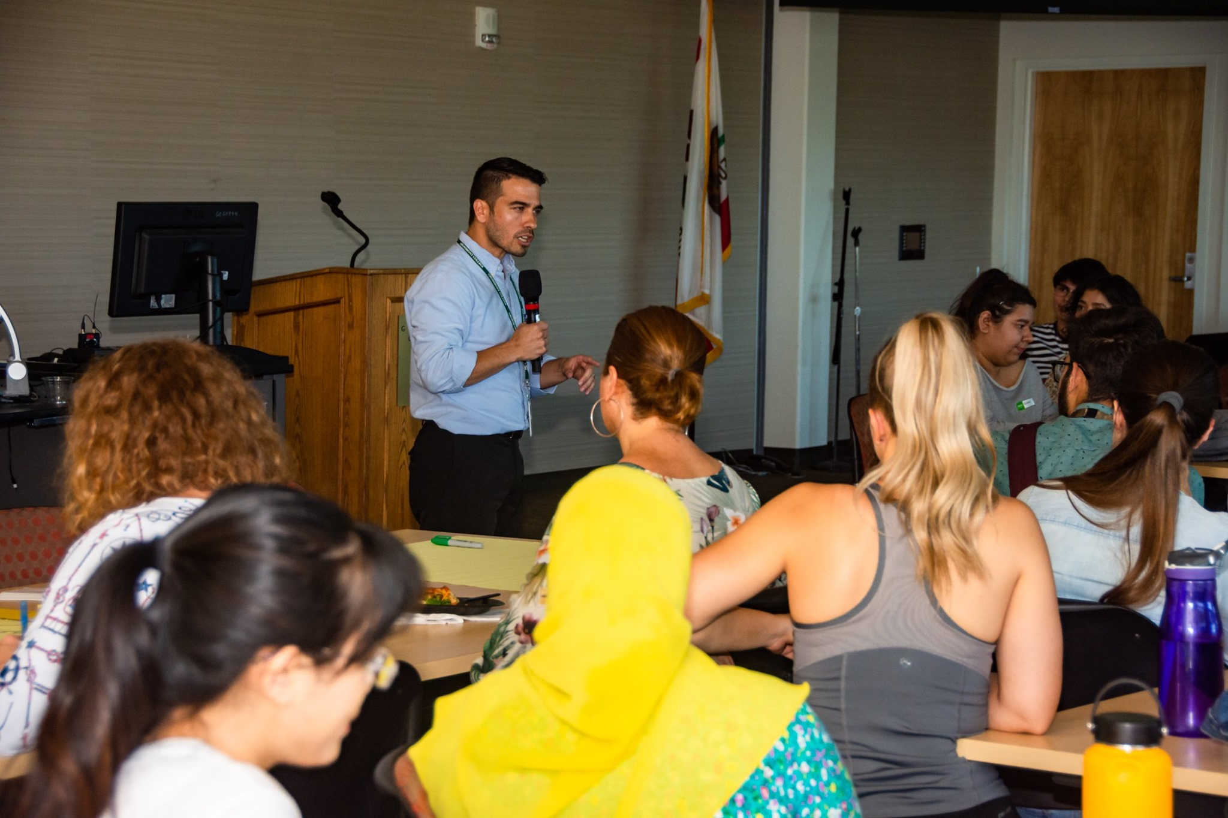
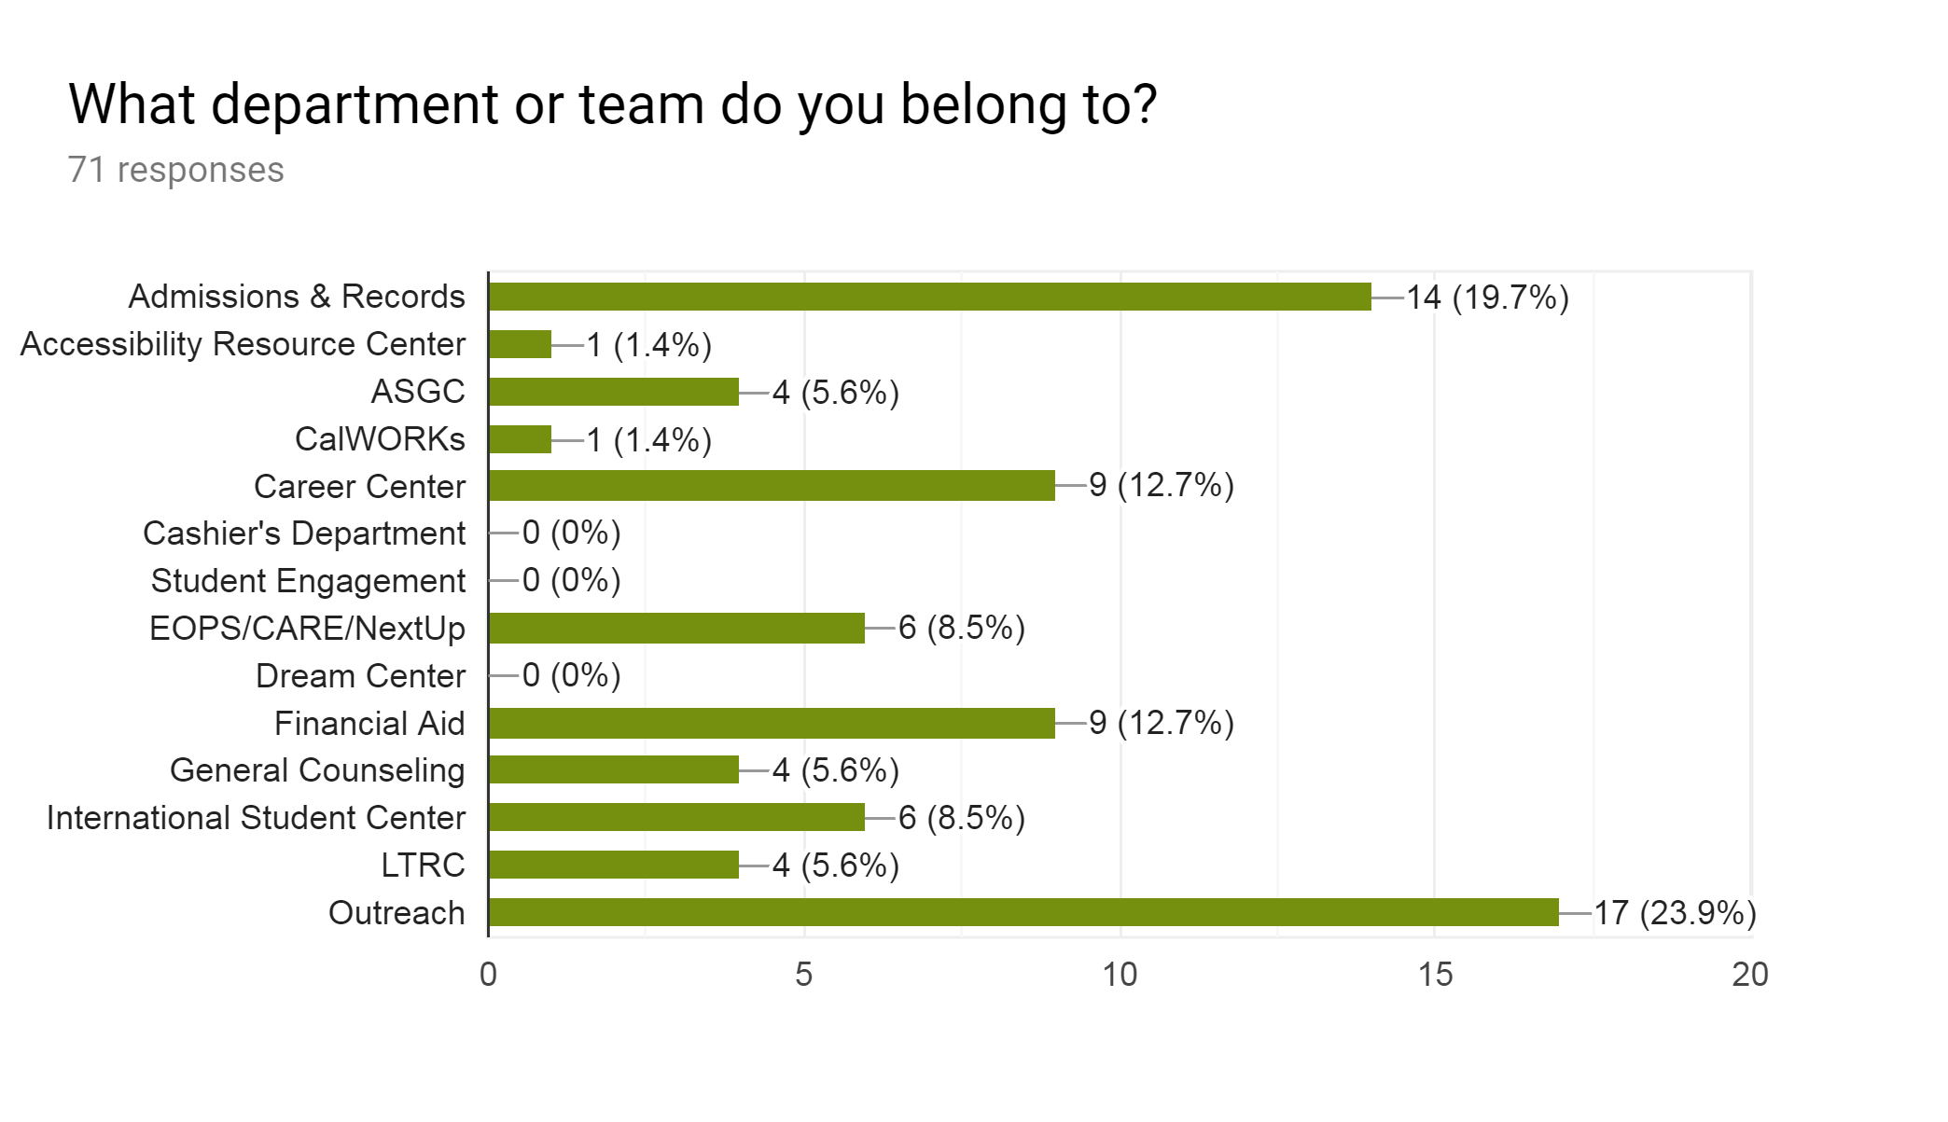
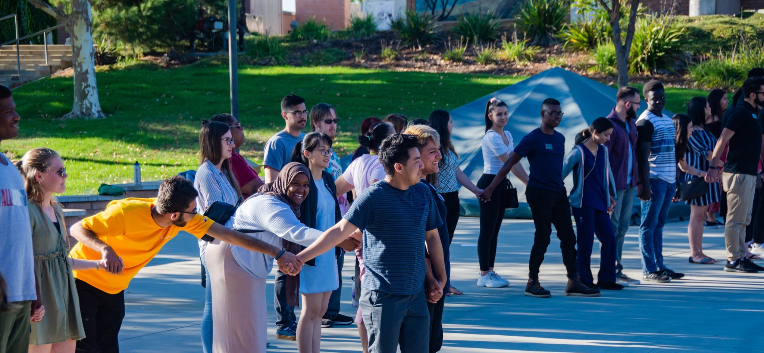
Programs Represented

Slide 4
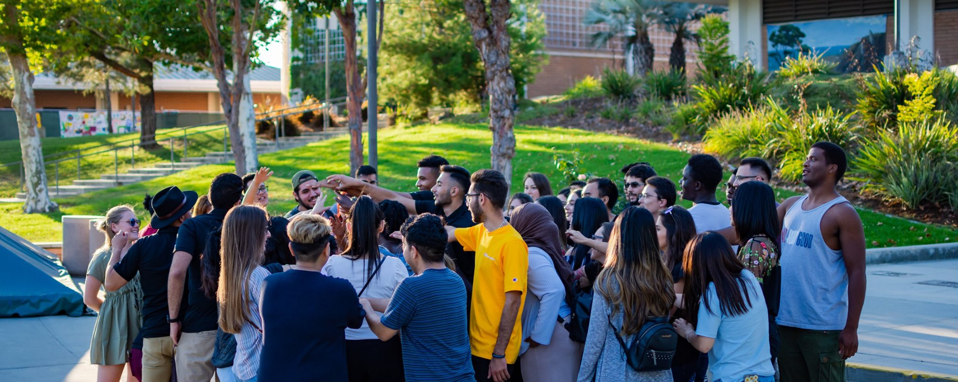
Communities Represented

Slide 5
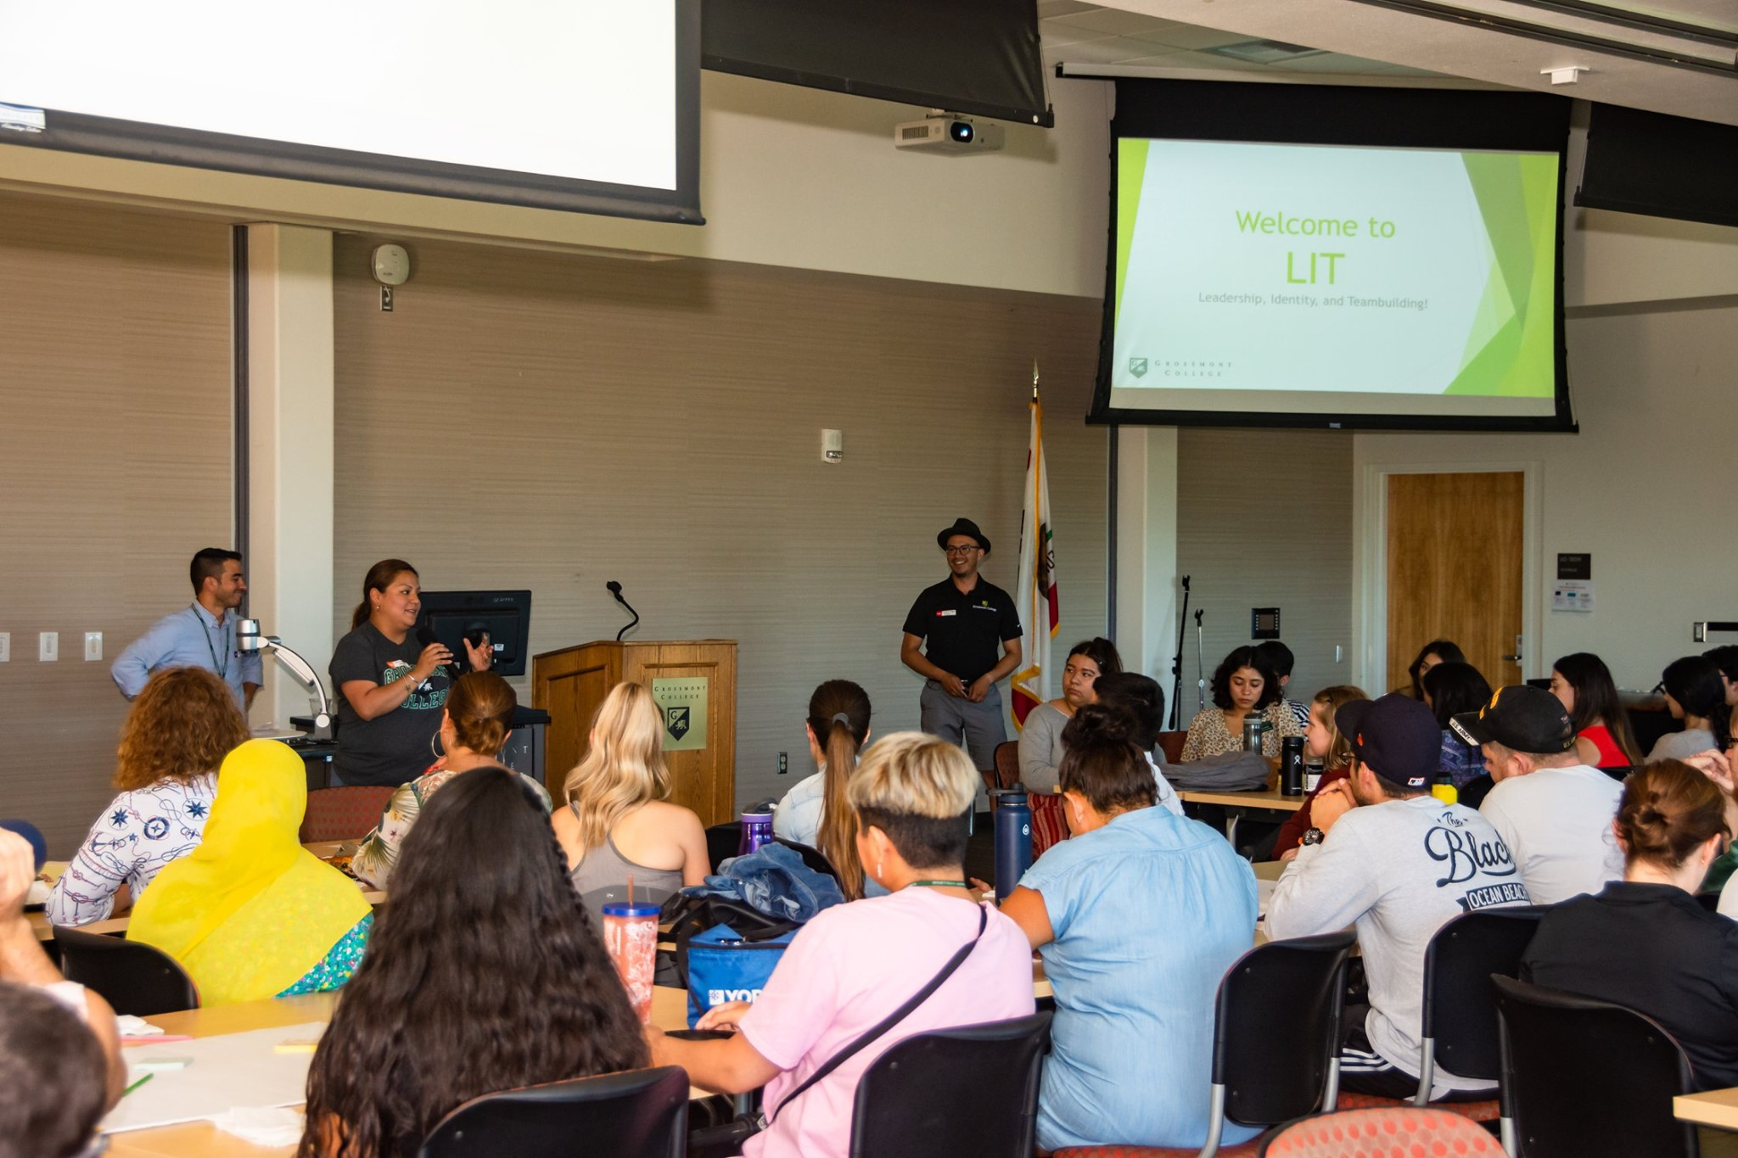
Theoretical Underpinnings
Social Change Model
(Astin, H.S. and Astin, A.W.. A Social Change Model of Leadership Development Guidebook Version III. The National Clearinghouse of Leadership Programs, 1996. Blueprint Leadership Development Program at UC Berkeley.

Slide 6
Program Learning Outcomes & Schedule overview

Slide 7
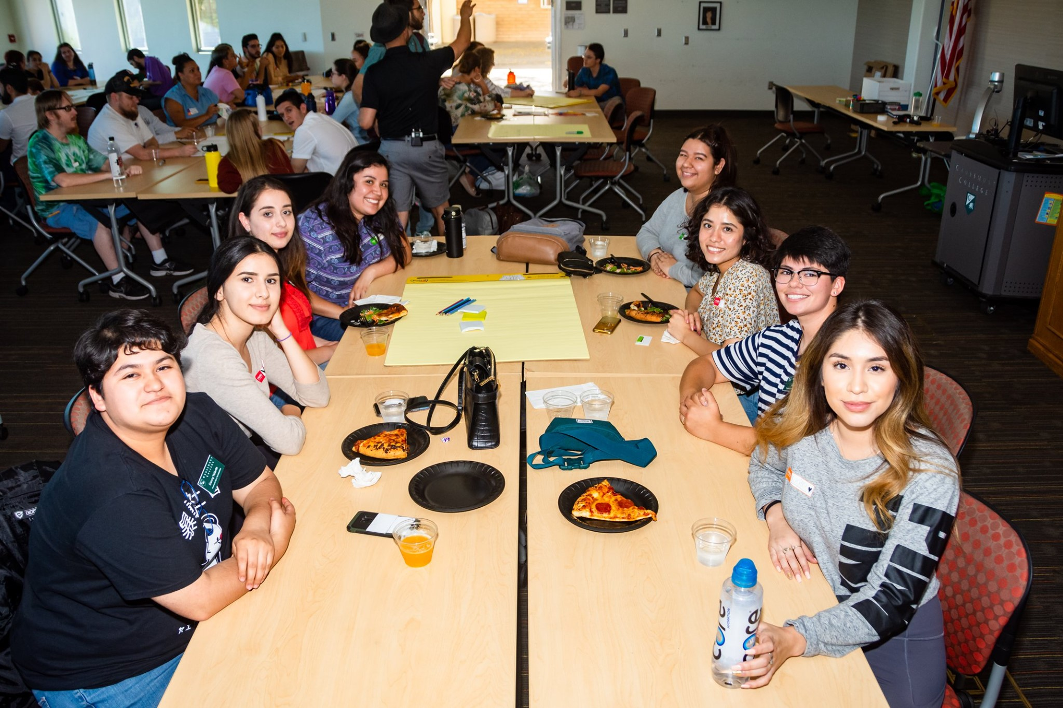
Findings: What is a leader? What does leadership mean to you?
"I think leader is an individual who is conscious about their strengths and weaknesses, and who takes responsibility for their actions and engages others to participate by setting an example and acting first. Also a leader empowers people to believe in themselves and helps them to establish the best of their qualities while working together." - LIT Participant

Slide 8
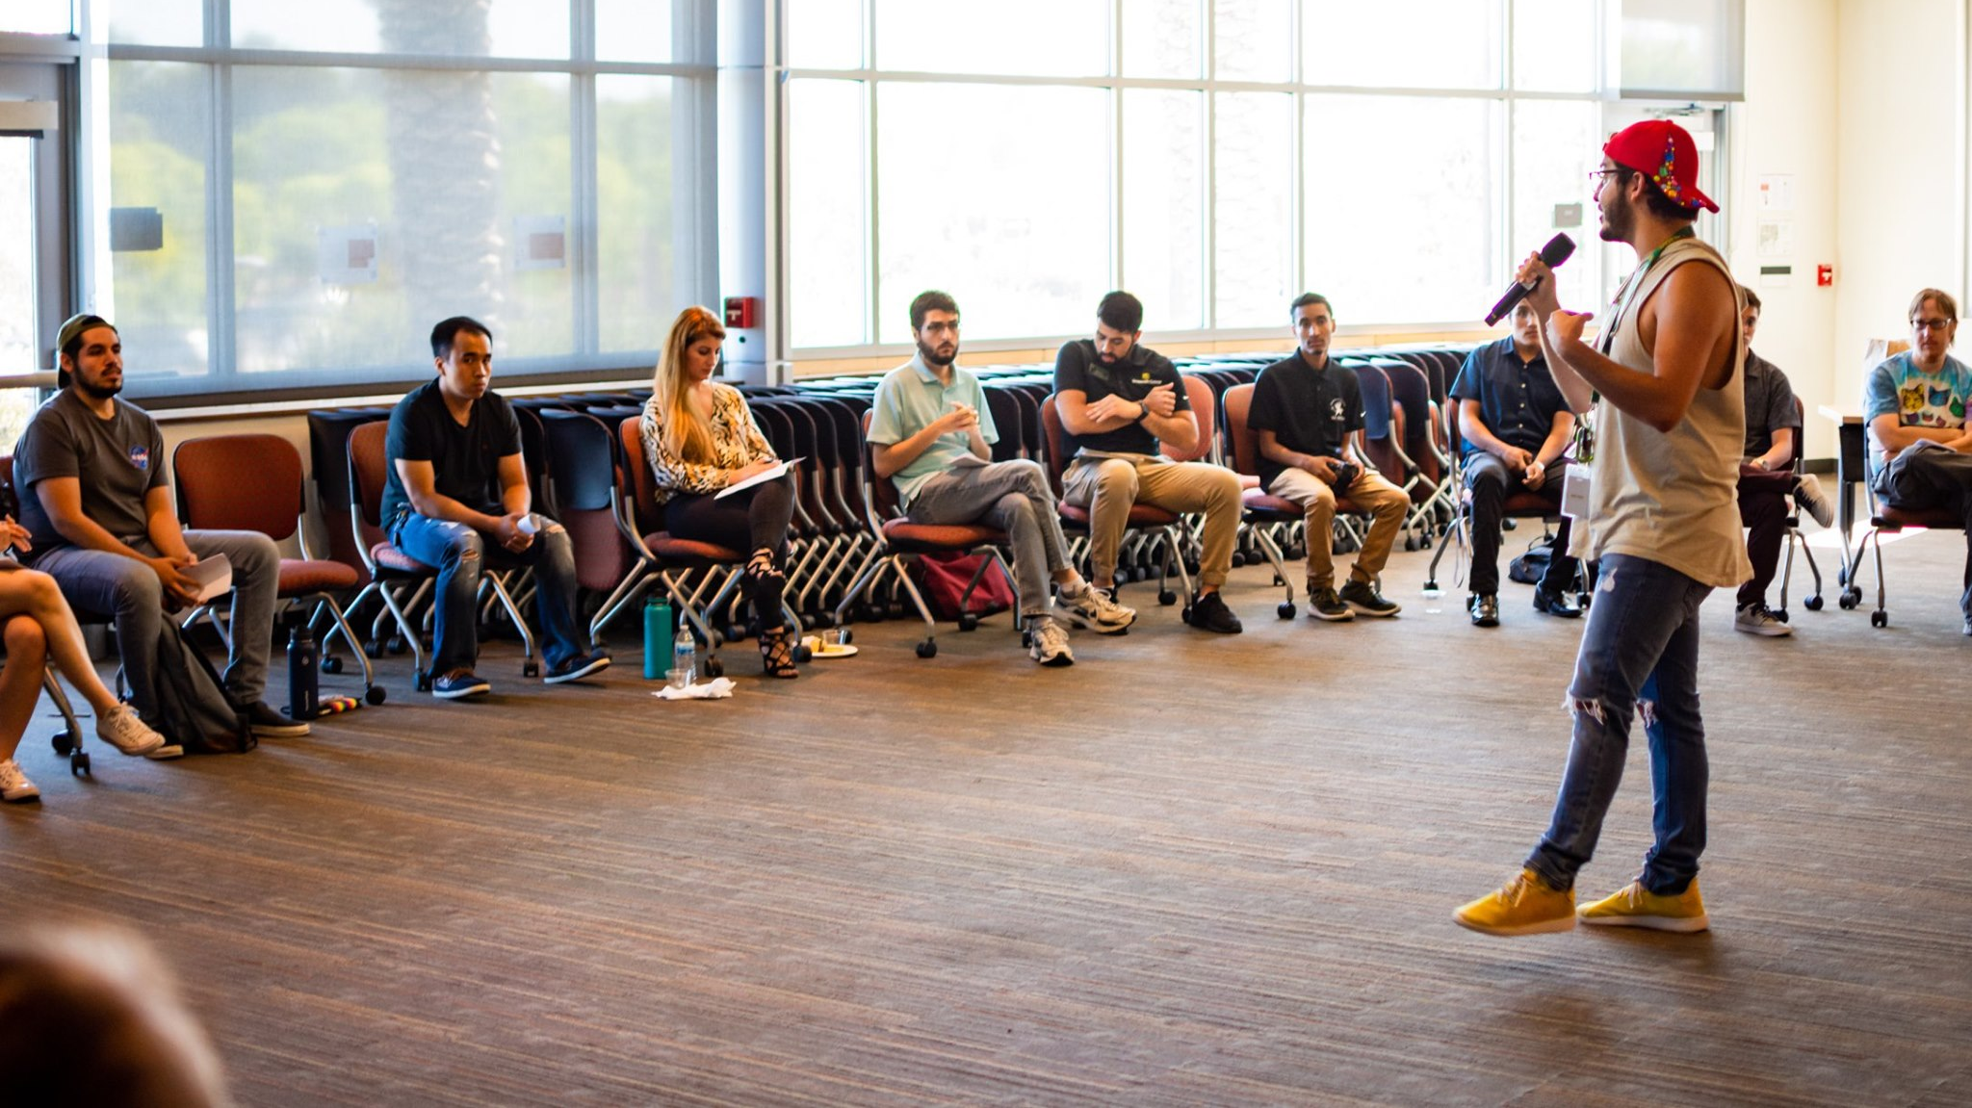
Findings: How does your identity influence your leadership style?
"It allows me to see the short comings of my community and be the change I want to see." - LIT Participant

Slide 9
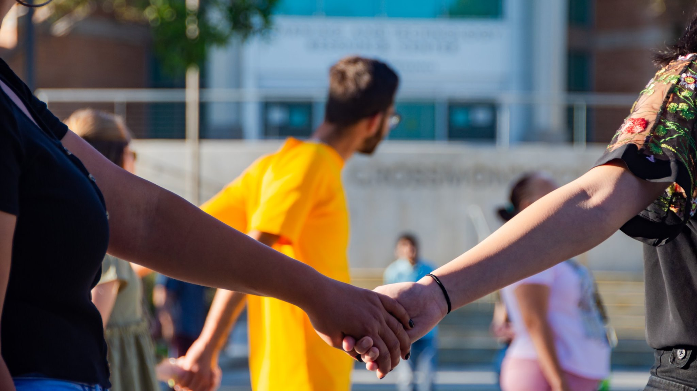
Findings: What does social equity and inclusion mean to you?
"Equity issues are disparities within our society and Inclusion is creating an environment in which any individual or group can be and feel welcomed, respected, supported, and valued to fully participate." - LIT Participant
"Social equity and inclusion means that all voices are equally represented and have a seat at the table. Those who serve their communities should reflect the communities they're in. It also means that the structures in place that are designed to create and uphold the social inequities we have are dismantled and restructured to foster real equity and inclusion."
- LIT Participant

Slide 10
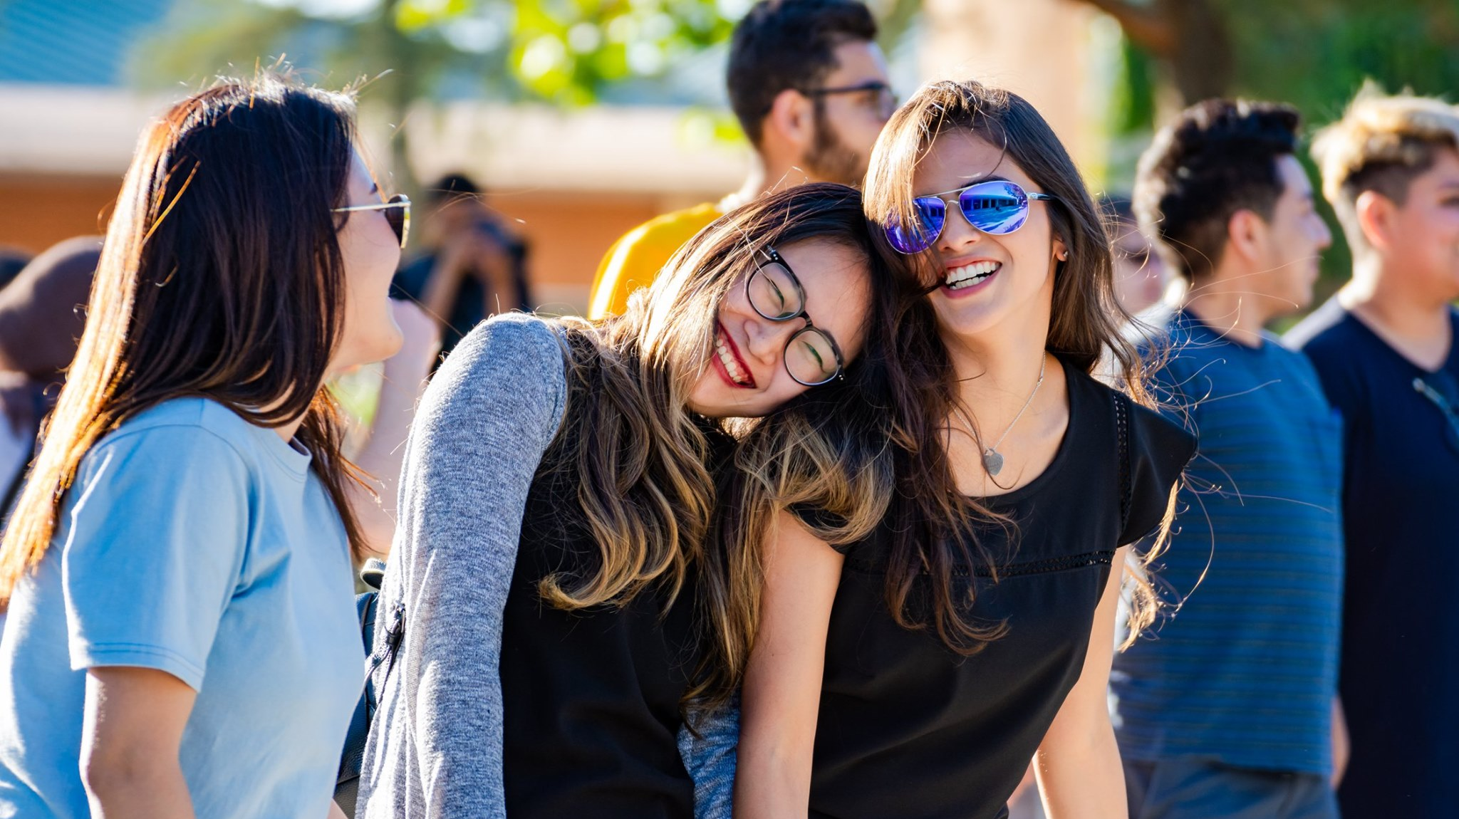
Findings: What are key components that create a successful team?
Communication
Teamwork
Responsibility
Flexibility
Cooperation
Support
Good leadership
Respect

Slide 11
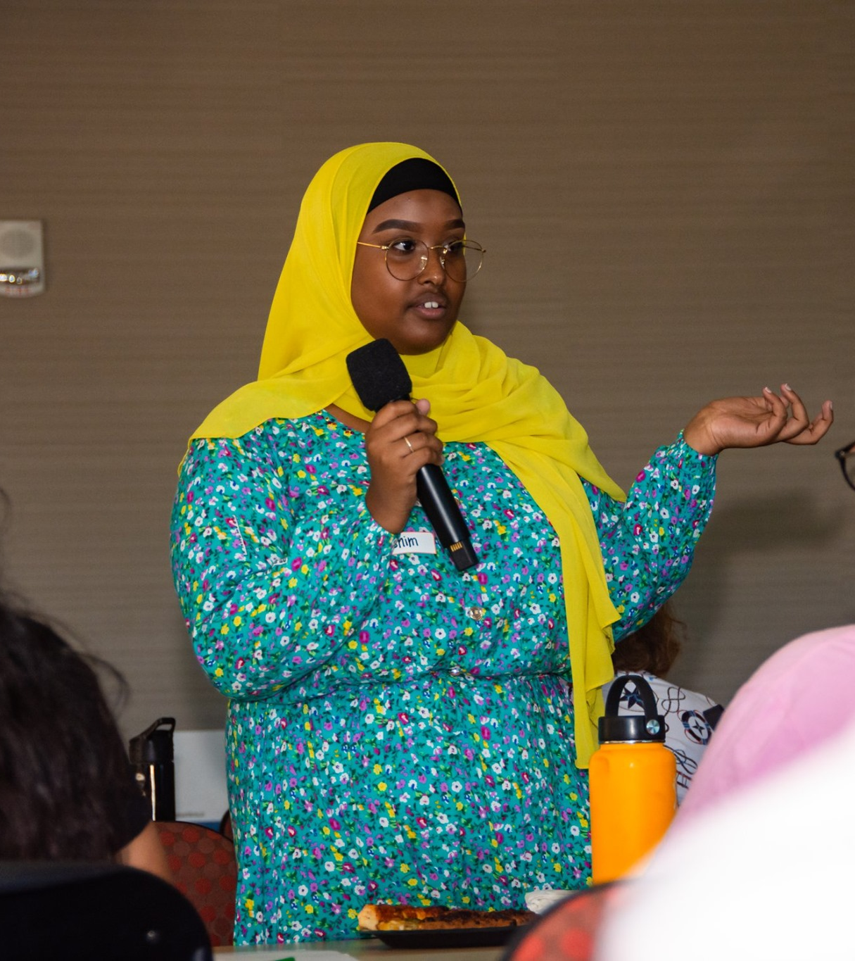
Findings: How does your current role support the greater mission of Grossmont College?
"I try my best to limit barriers for the students to receive their financial aid by providing correct information. I also try to direct them to resources and programs on campus." - LIT Participant
I want to make finding the right resources on campus easy for the students so that they don't walk in circles the way I did when I first got here. Our role is a role of encouragement! - LIT Participant
As a whole, to build a greater community and environment for students, being supportive, helpful and friendly. Also, to develop social projects, in order to grow our community. - LIT Participant

Slide 12
Thank You
Special thanks to Dr. Gable for supporting this program and for seeing the value of student leader specific professional development.

